Slide 1


ENTERPRISE WORKPLACE INTELLIGENCE
AI-Powered Workplace
Analytics
Space Utilization & Occupancy Monitoring Solution
“ Transforming CCTV infrastructure into actionable workplace intelligence ”
Privacy-by-design · DPDP-ready
Notes:
Cover. Lead with the promise: Trinetra turns the cameras a building already has into anonymous, real-time analytics on how space is actually used. Emphasize the two framing words — 'space utilization' and 'privacy-by-design' — because HR, IT, Facilities and Finance will all be alert to surveillance concerns. We measure occupancy and utilization of desks, meeting rooms and the cafeteria. We do not identify, name, or rank individual employees. If asked about privacy, answer confidently: the system counts people and reads zones, it does not recognize faces or track named individuals.

Slide 2





ABOUT TRINETRA SYSTEMS
Edge AI, engineered for the real world
We design and deploy computer-vision systems that run directly on cameras and edge devices — no cloud dependency, no data leaving the premises.
AI & Computer Vision
Edge Analytics
Custom YOLO detection models tuned to each site’s cameras and layout.
Inference on NVIDIA Jetson at the source — low latency, low bandwidth.
50+
99.9%
site
System uptime
100%
24×7
End-to-End Delivery
Privacy by Design
On-prem processing
Field reliability
Hardware, models, dashboards and deployment from a single partner.
Anonymous occupancy analytics — no facial recognition, DPDP-ready.
02
Notes:
About slide. Position Trinetra as an edge-AI specialist, not a generic CCTV reseller. The differentiator is that everything runs on-premises on NVIDIA Jetson — video never leaves the building, which is both a performance story (low latency, low bandwidth) and a privacy/security story. Walk the four strengths clockwise. Close on 'Privacy by Design': this is the strength that de-risks the whole conversation for HR and IT, so land it deliberately.

Slide 3





THE PROBLEM
You pay for space you can’t actually measure
Employee Productivity
Employee are not spend much time on desk.
THE HIDDEN COST
30–40%
Meeting rooms sit idle
Rooms are blocked on calendars but empty in reality — capacity is wasted.
of corporate real estate typically sits under-utilized at any given hour.
Inefficient desk usage
Hybrid work leaves large floor areas under-occupied and over-leased.
Every unmeasured square foot is rent, power and cleaning spend with no usage data behind it.
You can’t optimize what you don’t measure.
No cafeteria insight
Peak-hour crowding and off-peak emptiness go unmeasured.
Manual reporting
Facilities rely on walk-arounds and spreadsheets — slow and subjective.
03
Notes:
Problem slide. The narrative pivot is from 'we have cameras' to 'we have no data'. Each row is a blind spot facilities teams live with daily. Use the right-hand panel as the emotional hook for Finance: 30–40% of expensive real estate is idle at any given hour, and today nobody can prove which 30–40%. End on the line 'you can't optimize what you don't measure' — that sets up the solution slide.

Slide 4





THE SOLUTION
From existing cameras to executive insight
1
2
3
4
5
CCTV Cameras
YOLO AI Detection
Jetson Edge Device
Analytics Engine
Dashboards & Reports
Use the cameras already installed across the site.
Real-time detection of people, seats and zones.
On-prem inference — no video leaves the building.
Occupancy, utilization and trends computed live.
Clear insight for HR, Facilities and leadership.
Anonymous by design. The pipeline counts people and reads zones to produce occupancy data — it does not perform facial recognition or identify individuals.
Notes:
Solution overview. Walk the five stages left to right as one sentence: existing cameras feed a YOLO model, which runs on a Jetson on-site, which feeds an analytics engine, which produces dashboards. The key commercial point is stage 1 — we reuse the cameras the client already owns, so this is a software-and-edge upgrade, not a rip-and-replace. The bottom band restates the privacy guarantee at the architecture level: counting and zone-reading, never face recognition.

Slide 5
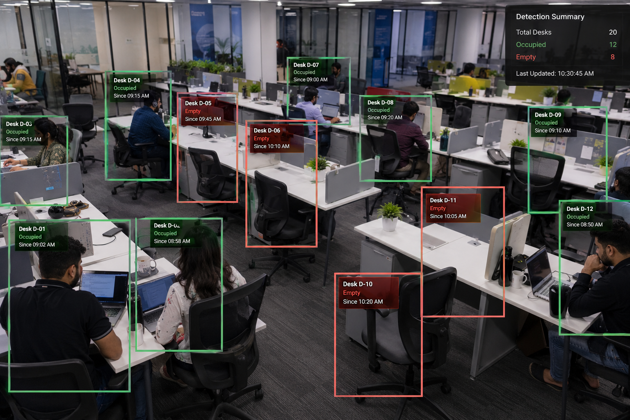






PRIMARY USE CASE
Desk Occupancy & Utilization
Desk occupancy tracking
Live occupied / vacant status for every desk.
Productive desk time
Aggregate hours desks are actively in use.
Idle desk detection
Surfaces seats left empty across the day.
Peak occupancy hours
When floors fill up and when they empty.
Floor-wise utilization
Compare usage across floors and zones.
Utilization rate
Live YOLO desk detection
One clear number for space efficiency.
05
Notes:
Primary use case — desks. This is the headline application and the one with the biggest financial lever, so spend time here. The image is a real detection view: green boxes are occupied desks, red are vacant, with a live summary panel (20 desks, 12 occupied, 8 empty). Note the framing — we report occupancy and aggregate 'desk time', not who sat where or how hard anyone worked. The six capabilities on the right all roll up into one number facilities cares about: utilization rate. Bridge to the next slide: 'here's what that looks like as a dashboard.'

Slide 6
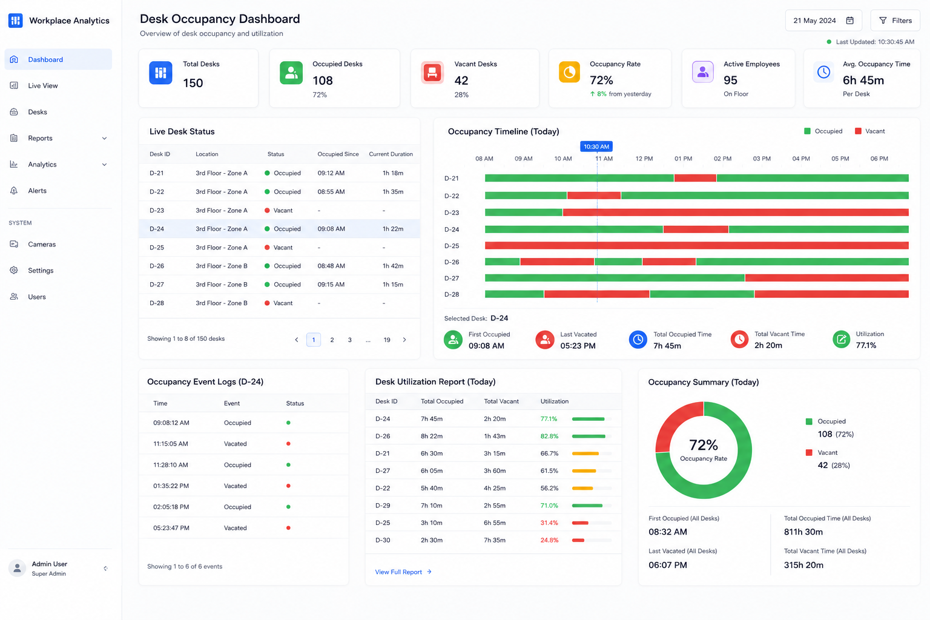

DESK ANALYTICS
The desk occupancy dashboard
150
Total Desks
108
Occupied
72%
Occupancy Rate
6h 45m
Avg Desk Time
11 AM–12 PM
Peak Window
06
Notes:
Desk dashboard. This is what the client logs into. Point out the live desk table, the occupancy timeline (green = occupied, red = vacant across the day), and the summary donut. The KPI rail on the right is the executive read: total vs occupied desks, occupancy rate, average desk time, and the peak window. Everything is aggregate and trend-level. Make the ROI point explicitly: 150 desks at 72% occupancy means roughly 42 desks of headroom — that is real estate that can be consolidated or sub-let.

Slide 7



LIVE DETECTION
YOLO desk detection in real time
Occupied desk detection
Each in-use desk boxed and timed.
Empty desk detection
Vacant seats flagged instantly.
Real-time occupancy
Live counts update continuously.
Historical usage
Every reading stored for trend analysis.
Notes:
Live detection detail. Use this to make the technology tangible and to pre-empt the 'is this accurate?' question. Walk one or two boxes on the image: green occupied, red empty, each with a timestamp. Stress that detection is desk- and zone-based — the model recognizes that a seat is occupied, not who occupies it. Every reading is logged, which is what powers the historical trends on the dashboards. This is the proof behind the numbers.

Slide 8





FACILITIES PLANNING
After-hours building utilization
Aggregate late-occupancy by floor and zone — to plan HVAC, lighting, security and energy spend. Reported as anonymous headcount and duration, never individual tracking.
Late occupancy
Occupancy duration
Zone & floor split
Headcount still on each floor after standard hours.
How long zones stay active into the evening.
Which areas drive after-hours usage.
After-Hours Headcount by Floor (post 7 PM, weekly avg)
WHY IT MATTERS
Workforce & shift planning
Employee wellbeing & safety
Energy & HVAC optimization
08
Notes:
After-hours analysis — reframed deliberately. The original concept was 'who is staying late', which is individual surveillance and a legal and morale risk. We sell the same data as anonymous building-utilization: how many people, on which floors, for how long after standard hours. That is genuinely useful to Facilities for HVAC, lighting, security rostering and energy cost — and it is defensible. If a client pushes for named overtime tracking, flag it as a compliance conversation for their HR and legal teams, not a default feature. The wellbeing point (spotting chronically overloaded floors) reframes it as a duty-of-care tool.

Slide 9
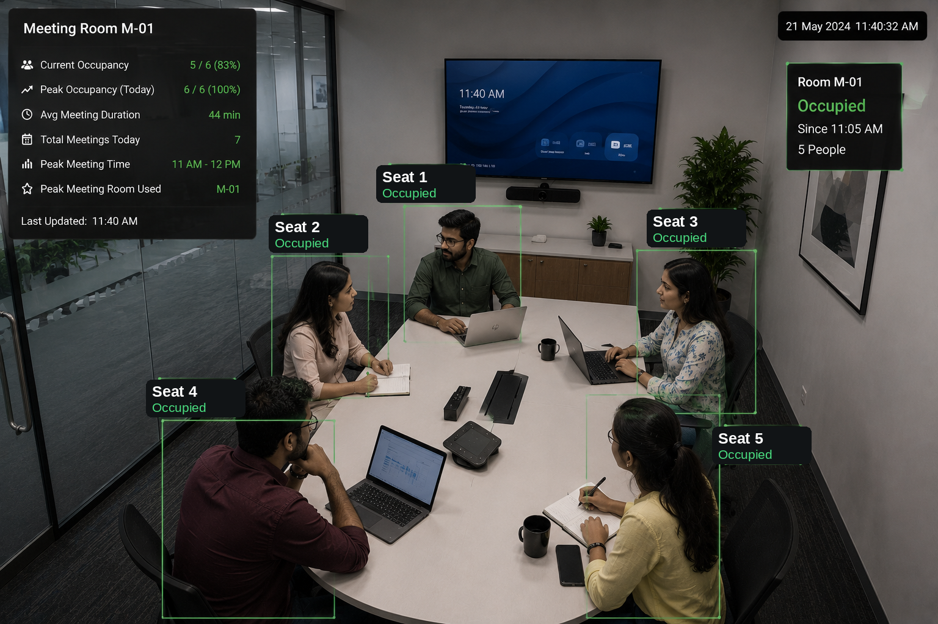




USE CASE
Meeting Room Utilization
Room occupancy
Occupied vs free, in real time.
Attendee count
How many seats are actually used.
Peak meeting hours
When demand for rooms spikes.
Utilization %
Booked time vs actual usage.
Most-utilized rooms
Spaces under genuine pressure.
Least-utilized rooms
Live room occupancy detection
Candidates to repurpose.
09
Notes:
Meeting rooms. The detection view shows occupancy and a count of people in the room plus a room-level summary (current occupancy, peak, average duration). The high-value insight is the gap between booked and actually-used: rooms blocked on calendars but empty, and over-subscribed rooms that signal you need more of a certain size. The most/least-utilized split tells facilities exactly which rooms to add, keep, or repurpose. Again: occupancy and counts, no identity.

Slide 10
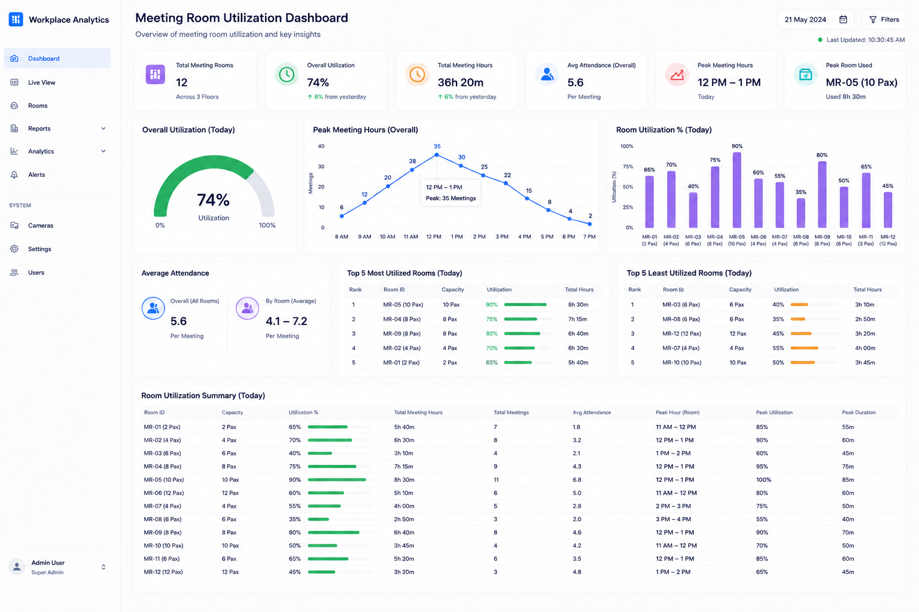
MEETING ANALYTICS
The meeting room dashboard
12
Meeting Rooms
74%
Overall Utilization
5.6
Avg Attendance
12–1 PM
Peak Hours
MR-05
Top Room
10
Notes:
Meeting dashboard. Highlight room-wise utilization %, average attendance per room, peak hours, and the most/least-utilized league tables. The story for an office manager: at 74% overall utilization with clear peak-hour congestion at lunch, you can right-size the room mix — convert dead rooms, add capacity where MR-05 is maxed. Average attendance vs room capacity also tells you if people book eight-seaters for two-person calls.

Slide 11
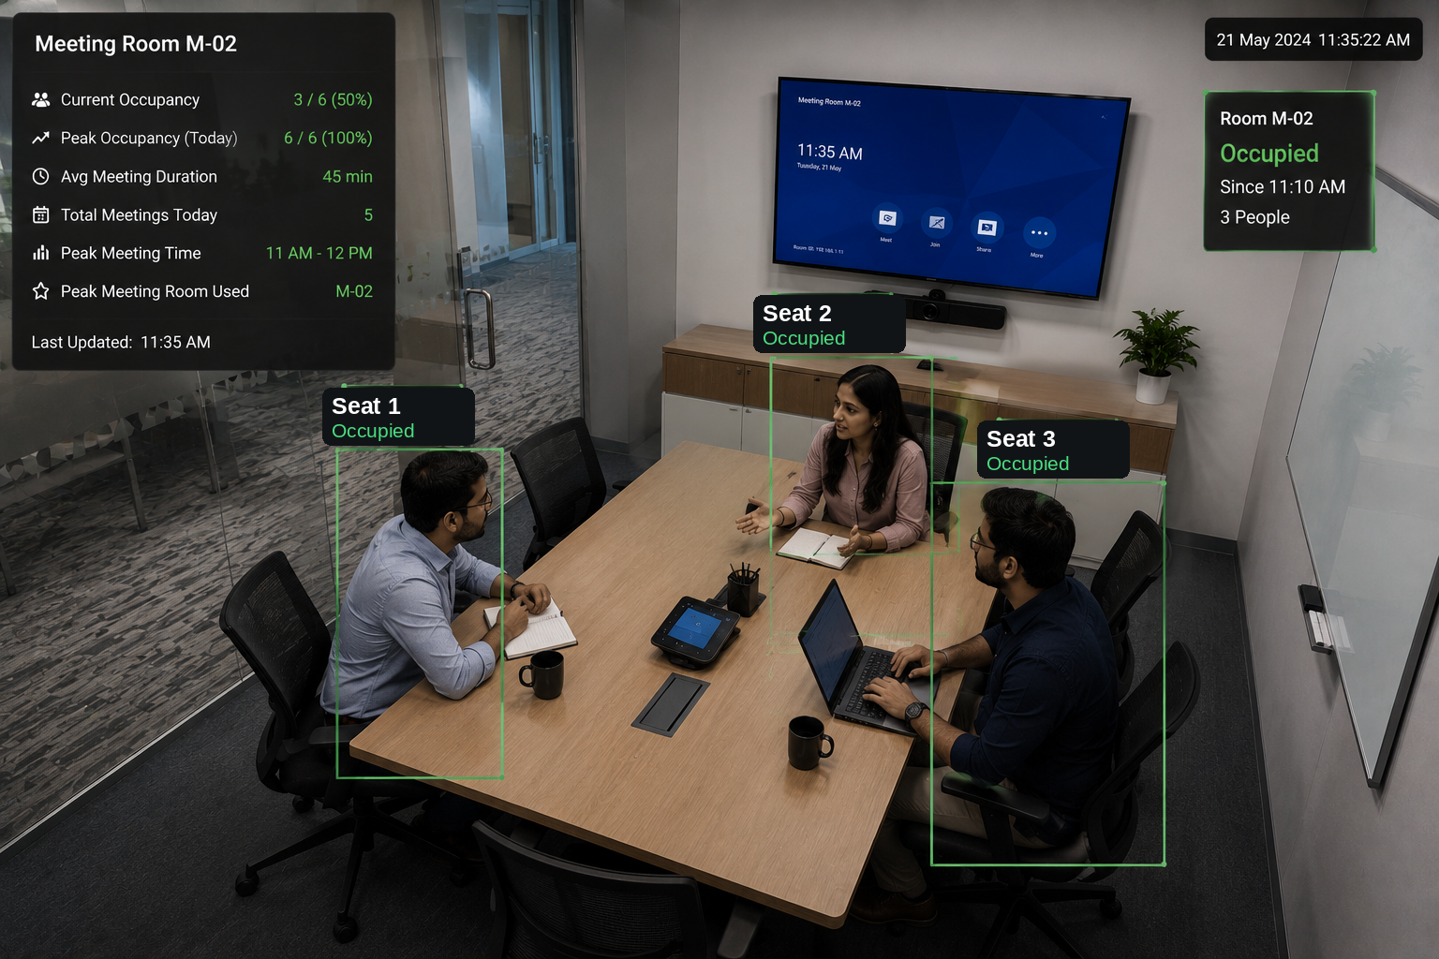
LIVE DETECTION
Meeting room AI detection
Attendee detection
Counts occupied seats per room.
Occupancy monitoring
Occupied / free status, live.
Utilization tracking
Actual use vs booked time.
Real-time analytics
Dashboards update continuously.
Notes:
Live meeting detection. The overlay shows the room marked Occupied, a seat count, and a room summary panel with current/peak occupancy and average duration. Make the same accuracy and privacy points as the desk detail slide: the system detects how many seats are in use, not who is in them. This live view is what generates the utilization numbers on the previous dashboard.

Slide 12
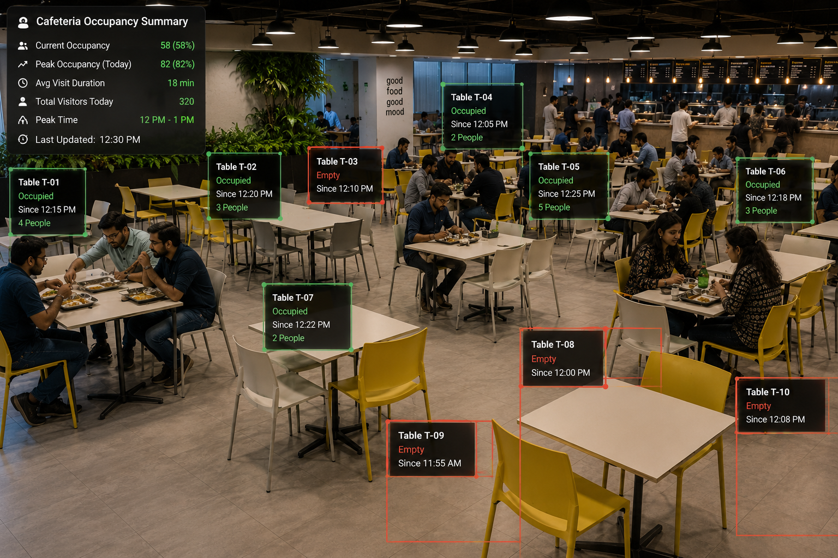


USE CASE
Cafeteria Utilization
Current occupancy
Live count of people and tables in use.
Peak occupancy
Busiest moments of the day.
Avg visit duration
How long people typically stay.
Total visitors
Daily footfall through the space.
Peak lunch hour
Live table occupancy detection
The single busiest service window.
12
Notes:
Cafeteria. The detection view tags tables as occupied or empty with people counts and a live occupancy summary (current, peak, average visit, total visitors, peak time). For facilities and the catering vendor this drives staffing, food prep volumes, and seating layout. For HR it informs flexible lunch windows to relieve the 12–1 crush. All table- and headcount-level; no individuals tracked.

Slide 13
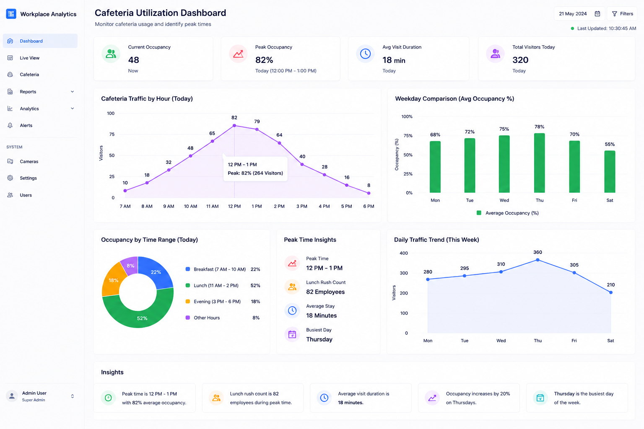

CAFETERIA ANALYTICS
The cafeteria dashboard
Peak Time
12 PM – 1 PM at 82% occupancy
Lunch Rush
82 employees in the peak window
Avg Stay
18 minutes per visit
Weekly Trend
Thursday is the busiest day
13
Notes:
Cafeteria dashboard. Walk the traffic-by-hour curve (the lunch spike), the weekday comparison, and the time-range donut splitting breakfast/lunch/evening. The insight cards on the right are the takeaways: peak time and load, lunch-rush headcount, average dwell time, and busiest day. Concrete value: stagger lunch slots to flatten the 12–1 peak, and align catering staffing and food volumes to real demand instead of guesswork.

Slide 14





BUSINESS VALUE
One platform, value for every stakeholder
HR
Admin / Facilities
Management
Productivity & utilization visibility
Space optimization
Data-driven decisions
See how space supports the way teams actually work.
Right-size desks and rooms to real demand.
Lease, consolidate and invest with confidence.
Workforce & space insights
Resource & energy planning
Operational efficiency
Plan hybrid policy on evidence, not anecdote.
Drive HVAC, cleaning and catering from data.
Cut waste across the real-estate portfolio.
14
Notes:
Business benefits. This is the slide where you read the room and emphasize the chair that matters most. For HR: evidence for hybrid policy and space that fits how people work. For Facilities/Admin: the operational savings — right-sizing, energy, catering. For Management/Finance: the portfolio-level decisions, where the real money is (consolidating under-used floors). The point of the three columns is that one deployment pays back across all three functions, which makes the business case easy to sponsor jointly.

Slide 15






SYSTEM ARCHITECTURE
How the pieces fit together
1
CCTV Cameras
Existing IP cameras across desks, rooms and the cafeteria stream over the local network.
2
YOLO Detection
A tuned detection model identifies people, seats and zones frame-by-frame.
3
Jetson Orin Nano
All inference runs on-premises at the edge — raw video never leaves the building.
4
Analytics Engine
Detections become occupancy, utilization, dwell-time and trend metrics.
5
Dashboards & Reports
Live dashboards and exportable reports for HR, Facilities and leadership.
16
Notes:
System architecture. This is the engineer's-eye view for the IT Head. Read it top to bottom as a data flow. The non-negotiable line is layer 3: inference happens on the Jetson on-site, so raw video stays inside the network — only derived, anonymous metrics move onward. That single design choice answers most IT security and data-residency questions before they're asked. No cloud video, no per-frame data leaving the building.

Slide 16



CAPABILITIES
Everything in one platform
Real-Time Analytics
Desk Occupancy Monitoring
Meeting Room Utilization
Cafeteria Analytics
Productivity & Utilization Tracking
Occupancy Heatmaps
Reports & Insights
Edge AI Deployment
17
Notes:
Key features. This is the at-a-glance capability summary — let the grid do the work, don't read every tile. If you've tailored the pitch to one use case, point out that the others come in the same platform at no extra hardware. Heatmaps and reports are worth a beat: heatmaps make utilization instantly legible to non-analysts, and scheduled reports mean leadership gets insight without logging in.

Slide 17




WHY TRINETRA SYSTEMS
A partner, not just a product
Custom AI Solutions
Edge AI Expertise
NVIDIA Partner Experience
Detection models tuned to your cameras, layout and goals.
Deep specialism in on-device inference and optimization.
Hands-on track record across the Jetson platform.
End-to-End Deployment
Enterprise Support
Privacy-First Engineering
From site survey and hardware to dashboards and handover.
Responsive technical support and ongoing maintenance.
Anonymous analytics, on-prem data — compliance built in.
Notes:
Why Trinetra. This is the trust slide before the commercials. The throughline: we own the whole stack — custom models, NVIDIA edge hardware, dashboards, deployment, and support — so the client has one accountable partner rather than a stitched-together set of vendors. Privacy-first engineering is listed as a core competency, not a disclaimer, which reinforces everything we've framed throughout. End by tying it to support and warranty next.

Slide 18
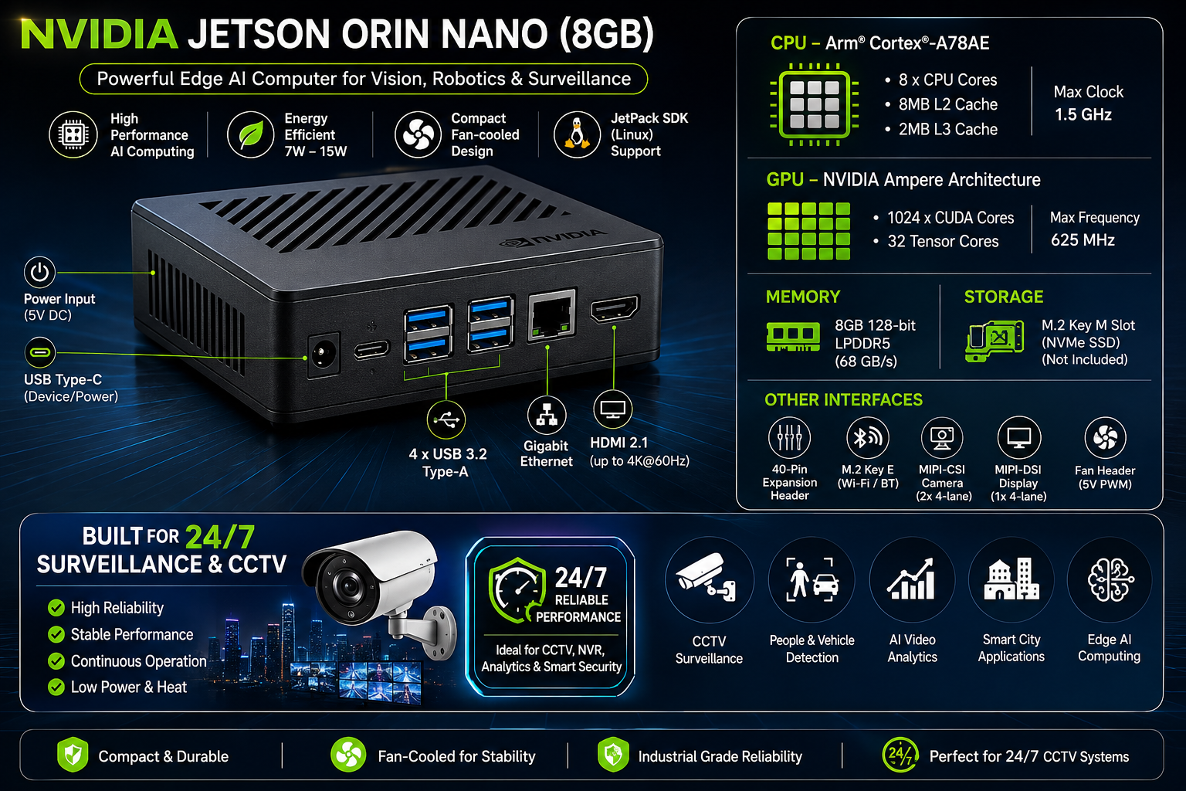



HARDWARE PLATFORM
NVIDIA Jetson Orin Nano
Edge AI Processing
1024 CUDA + 32 Tensor cores on-device.
Real-time YOLO Inference
Multi-stream detection at the source.
Low Power Consumption
Runs at just 7–15 W.
Industrial Deployment
Compact, fan-cooled, field-rugged.
24×7 Reliability
Built for continuous operation.
Notes:
Hardware. The Jetson Orin Nano is why on-prem, privacy-preserving analytics is even feasible at this price and power. Hit the four buying points: real AI compute at the edge (so video stays on-site), 7–15 W power (cheap to run, easy to place), industrial-grade and fan-cooled (survives a comms closet), and built for 24x7. Tie it back: this is genuine NVIDIA edge hardware, not a hobby board — which underpins the reliability and warranty story coming up.

Slide 19
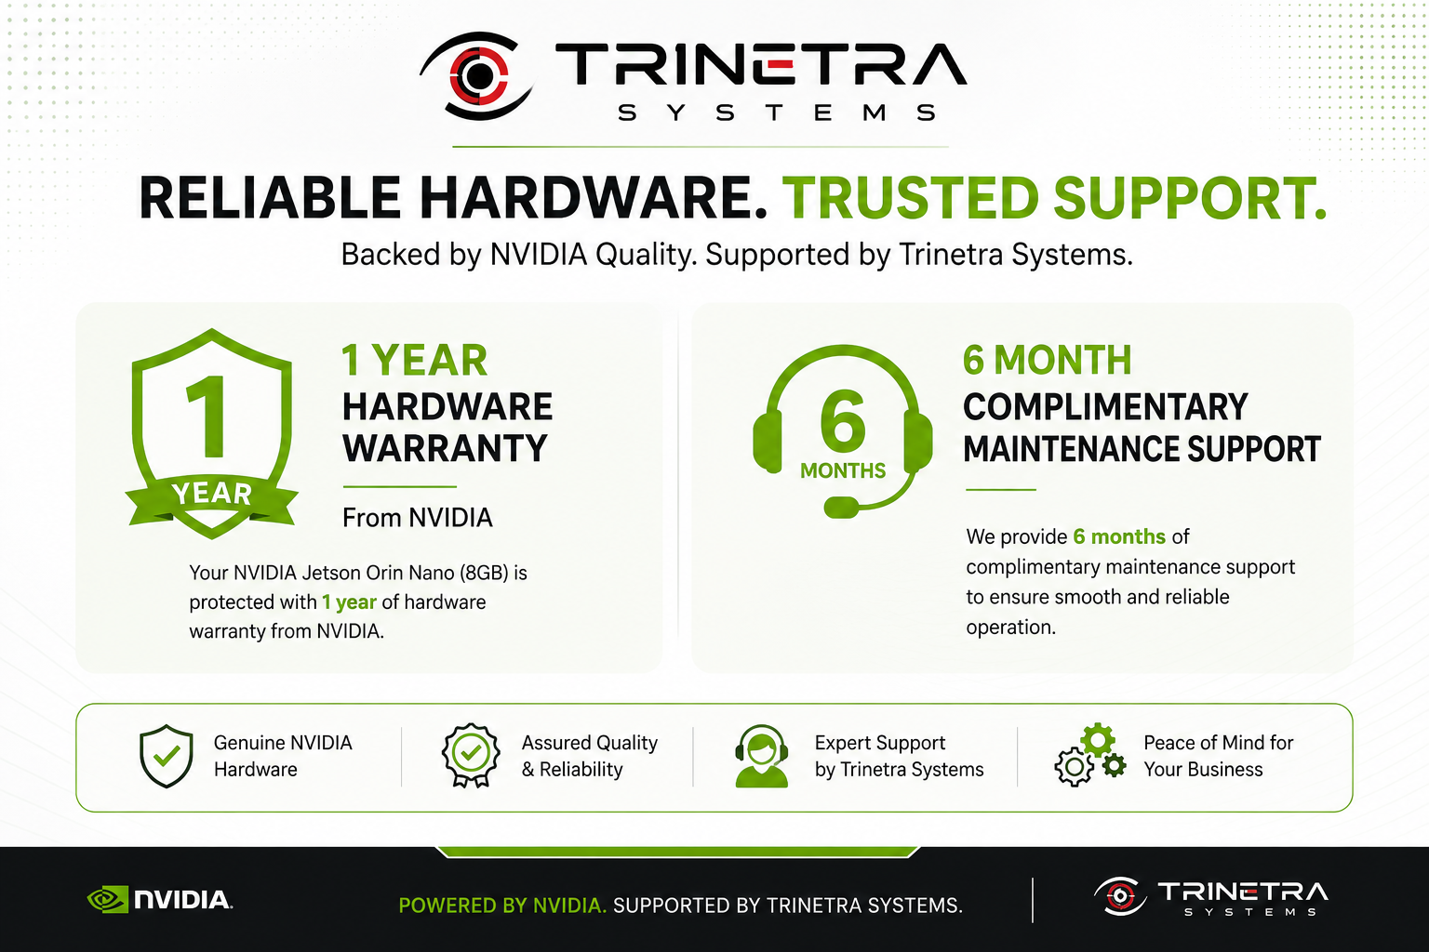




SUPPORT & WARRANTY
Reliable hardware. Trusted support.
1-Year Hardware Warranty
Genuine NVIDIA Jetson hardware, warranty-backed.
6 Months Maintenance
Complimentary maintenance for smooth operation.
Remote Technical Assistance
Fast remote diagnosis and resolution.
Deployment Support
Hands-on help through install and go-live.
19
Notes:
Support and warranty. De-risk the purchase. Four commitments: a one-year hardware warranty on genuine NVIDIA hardware, six months of complimentary maintenance, remote technical assistance, and hands-on deployment support. The message for IT: you are not on your own after install — Trinetra owns reliability with you. If asked, be ready to discuss extended AMC options beyond the included six months.

Slide 20
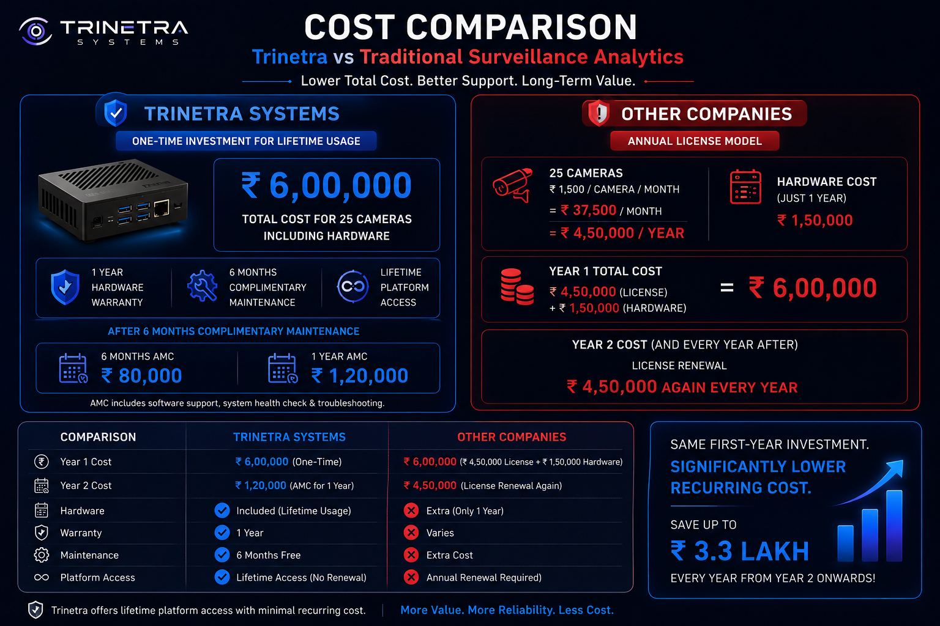

Slide 21
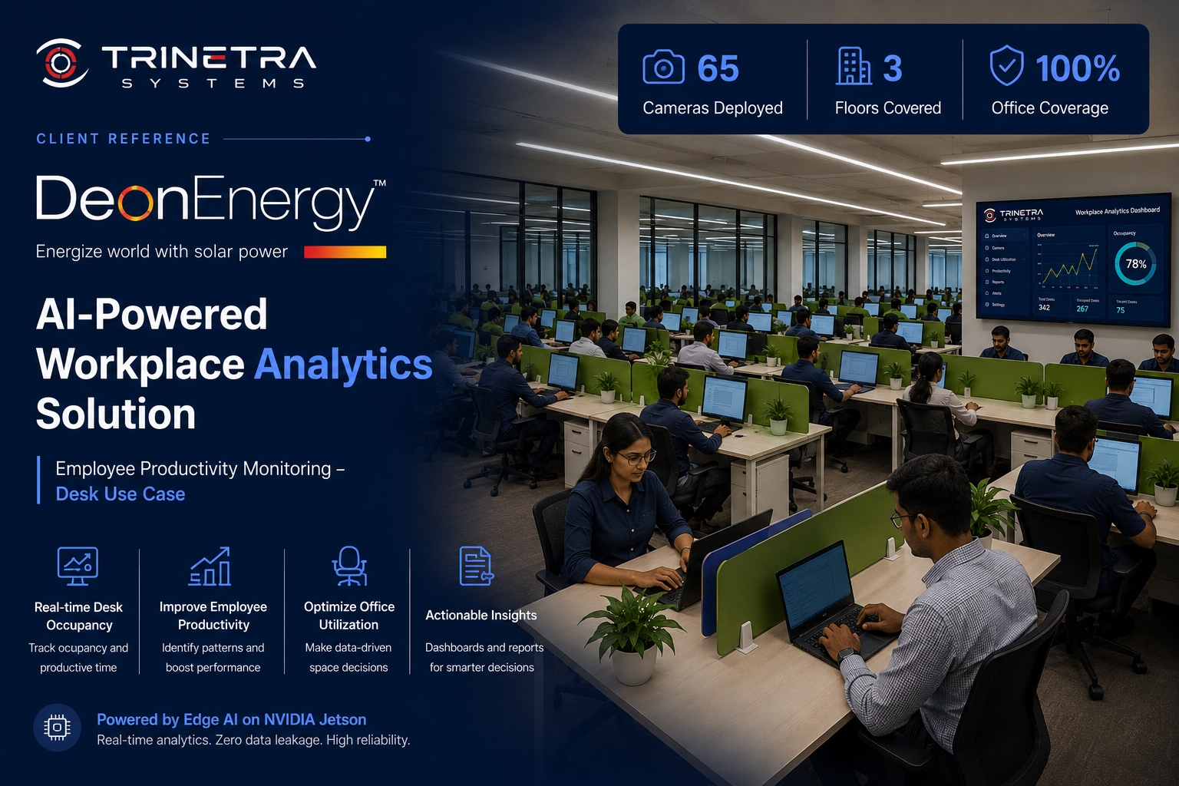

Slide 22

Thank You
Let’s turn your CCTV infrastructure into workplace intelligence.
www.trinetrasystems.com
Privacy-by-design · Edge AI · Enterprise Workplace Analytics
Notes:
Close. Restate the one-line value proposition and make a clear ask for the next step — typically a short site survey or a pilot on one floor, which is the lowest-friction way to prove the numbers. Point to the website for follow-up. Then stop talking and invite questions; let the room respond.

